Slide 1
Background Tasks
Android Developer Fundamentals V2
Lesson 7

Slide 2
7.3 Broadcasts

Slide 3
Contents
Broadcasts
Send a custom broadcasts
Broadcast receivers
Implementing broadcast receivers
Restricting the broadcasts
Best practices

Slide 4
Broadcasts

Slide 5
Broadcast vs. Implicit Intents
Broadcasts
Broadcasts are messages sent by Android system and other Android apps, when an event of interest occurs.
Broadcasts are wrapped in an Intent object. This Intent object’s contains the event details such as, android.intent.action.HEADSET_PLUG, sent when a wired headset is plugged or unplugged.

Slide 6
Broadcast vs. Implicit Intents
Types of broadcasts
Types of broadcast:
System broadcast.
Custom broadcast.

Slide 7
Broadcast vs. Implicit Intents
System broadcasts
System broadcast are the messages sent by the Android system, when a system event occurs, that might affect your app.
Few examples:
An Intent with action, ACTION_BOOT_COMPLETED is broadcasted when the device boots.
An Intent with action, ACTION_POWER_CONNECTED is broadcasted when the device is connected to the external power.

Slide 8
Broadcast vs. Implicit Intents
Custom broadcasts
Custom broadcasts are broadcasts that your app sends out, similar to the Android system.
For example, when you want to let other app(s) know that some data has been downloaded by your app, and its available for their use.

Slide 9
Send a custom broadcasts

Slide 10
Local Broadcast
Sends broadcasts to receivers within your app.
No security issues since no interprocess communication.
To send a local broadcast:
To get an instance of LocalBroadcastManager.
Call sendBroadcast() on the instance.
LocalBroadcastManager.getInstance(this)
.sendBroadcast(customBroadcastIntent);

Slide 11
Custom broadcasts
Sender and receiver must agree on unique name for intent (action name)
Define in activity and broadcast receiver
private static final String ACTION_CUSTOM_BROADCAST = "com.example.android.powerreceiver.ACTION_CUSTOM_BROADCAST";
customBroadcastIntent = new Intent(ACTION_CUSTOM_BROADCAST);

Slide 12
Broadcast Receivers

Slide 13
What is a broadcast receiver?
Broadcast receivers are app components.
They register for various system broadcast and or custom broadcast.
They are notified (via an Intent):
By the system, when an system event occurs that your app is registered for.
By another app, including your own if your app is registered for that custom event.

Slide 14
Register your broadcast receiver
Broadcast receivers can be registered in two ways:
Static receivers
Registered in your AndroidManifest.xml, also called as Manifest-declared receivers.
Dynamic receivers
Registered using app or activities' context in your Java files, also called as Context-registered receivers.

Slide 15
Receiving a system broadcast
Starting from Android 8.0 (API level 26), static receivers can't receive most of the system broadcasts.
Use a dynamic receiver to register for these broadcasts.
If you register for the system broadcasts in the manifest, the Android system won't deliver them to your app.
A few broadcasts, are excepted from this restriction. See the complete list of implicit broadcast exceptions.

Slide 16
Implementing Broadcast Receivers

Slide 17
To create a broadcast receiver
Subclass the BroadcastReceiver class and override its onReceive() method.
Register the broadcast receiver and specify the intent-filters:
Statically, in the Manifest.
Dynamically, with registerReceiver().

Slide 18
What are Intent-filters
Intent-filters specify the types of intents a broadcast receiver can receive. They filter the incoming intents based on the Intent values like action.
To add an intent-filter:
To your AndroidManifest.xml file, use <intent-filter> tag.
To your Java file use the IntentFilter object.

Slide 19
Subclass a broadcast receiver
In Android studio, File > New > Other > BroadcastReceiver
public class CustomReceiver extends BroadcastReceiver {
@Override
public void onReceive(Context context, Intent intent) {
// This method is called when the BroadcastReceiver
// is receiving an Intent broadcast.
throw new UnsupportedOperationException("Not yet implemented");
}
}

Slide 20
Implement onReceive()
Example implementation of onReceive() method which handles power connected and disconnected.
@Override
public void onReceive(Context context, Intent intent) {
String intentAction = intent.getAction();
switch (intentAction){
case Intent.ACTION_POWER_CONNECTED:
break;
case Intent.ACTION_POWER_DISCONNECTED:
break;
}
}

Slide 21
Register statically in Android manifest
<receiver> element inside <application> tag.
<intent-filter> registers receiver for specific intents.
<receiver
android:name=".CustomReceiver"
android:enabled="true"
android:exported="true">
<intent-filter> <action android:name="android.intent.action.BOOT_COMPLETED"/> </intent-filter>
</receiver>

Slide 22
Register dynamically
Register your receiver in onCreate() or onResume().
// Register the receiver using the activity context.
this.registerReceiver(mReceiver, filter);
Unregister in onDestroy() or onPause().
// Unregister the receiver
this.unregisterReceiver(mReceiver);

Slide 23
Register a Local broadcast receiver
Register local receivers dynamically, because static registration in the manifest is not possible for a local broadcasts.

Slide 24
Register a Local broadcast receiver
To register a receiver for local broadcasts:
Get an instance of LocalBroadcastManager.
Call registerReceiver().
LocalBroadcastManager.getInstance(this).registerReceiver
(mReceiver,
new IntentFilter(CustomReceiver.ACTION_CUSTOM_BROADCAST));

Slide 25
Unregister a Local broadcast receiver
To unregister a local broadcast receiver:
Get an instance of the LocalBroadcastManager.
Call LocalBroadcastManager.unregisterReceiver().
LocalBroadcastManager.getInstance(this)
.unregisterReceiver(mReceiver);

Slide 26
Alarms and Schedulers
Android Developer Fundamentals V2
Lesson 8

Slide 27
8.1 Notifications

Slide 28
Contents
What are notifications?
Notification channels
Creating a notification channel
Creating notifications
Tap action and action buttons
Expanded view notifications
Delivering notifications
Managing Notifications

Slide 29
What Are Notifications?

Slide 30
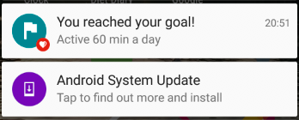
What is a notification?
Message displayed to user outside regular app UI
Small icon
Title
Detail text

Slide 31
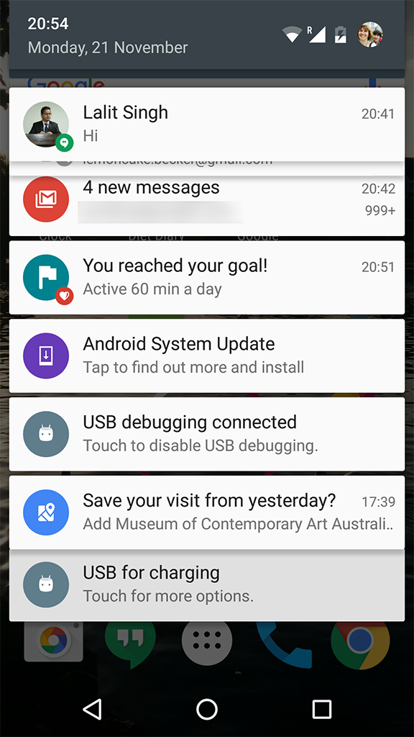
How are notifications used?
Android issues a notification that appears as icon on the status bar.
To see details, user opens the notification drawer.
User can view notifications any time in the notification drawer.

Slide 32
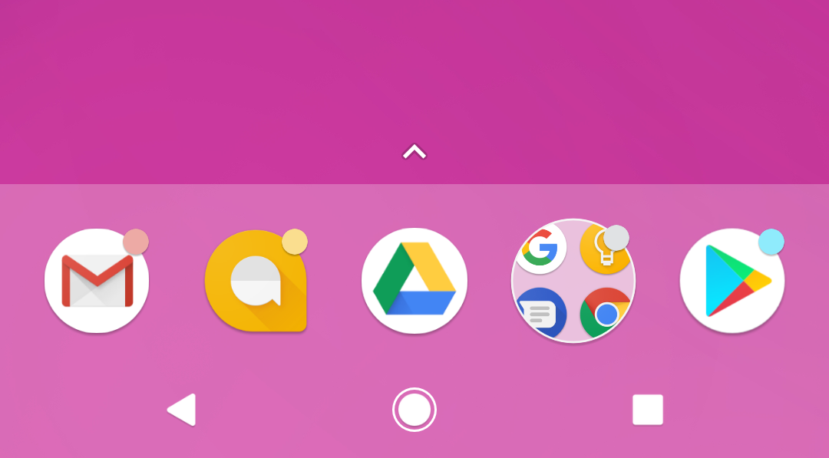
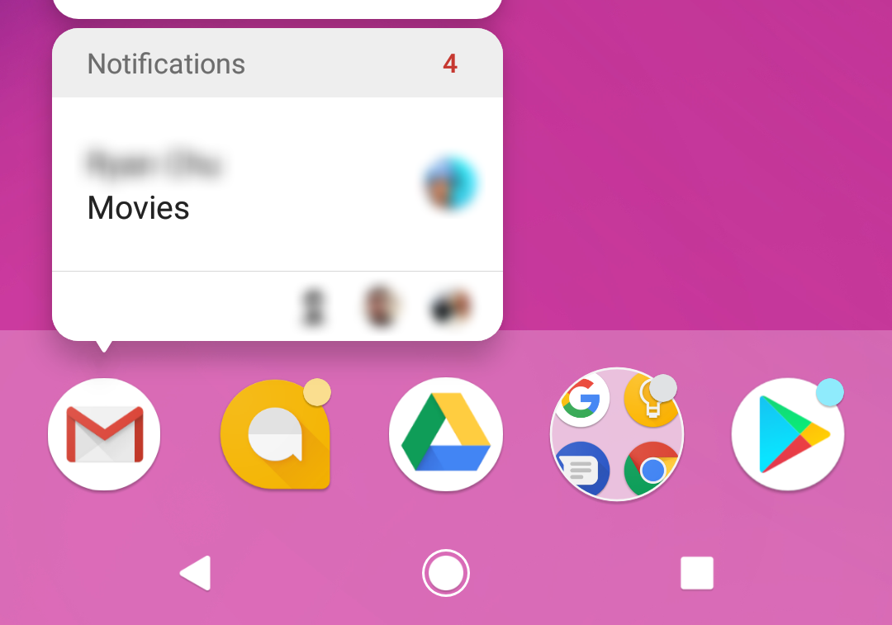
App icon badge
Available only on the devices running Android 8.0 (API level 26) and higher.
New notifications are displayed as a colored "badge" (also known as a "notification dot") on the app icon.
Users can long-press on an app icon to see the notifications for that app. Similar to the notification drawer.

Slide 33
Notification
Channels

Slide 34
Notification channels
Used to create a user-customizable channel for each type of notification to be displayed.
More than one notification can be grouped in to a channel.
Set notification behavior like sound, light, vibrate and so on, applied to all the notifications in that channel.

Slide 35
Notification channels are mandatory
Notification channels are introduced in Android 8.0 (API level 26)
All notifications must be assigned to a channel starting from Android 8.0 (API level 26), else your notifications will not be displayed.
For the apps targeting lower than Android 8.0 (API level 26), no need to implement notification channels.

Slide 36
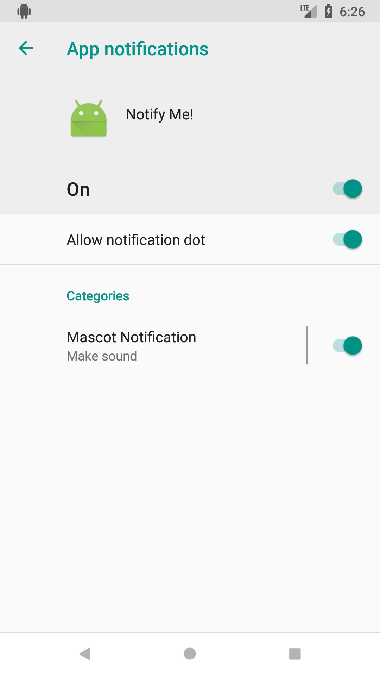
Notification channels in Settings
Notification channels appear as Categories under App notifications in the device Settings.

Slide 37
Creating a Notification channel

Slide 38
Create a Notification channel
Notification channel instance is created using NotificationChannel constructor.
You must specify:
An ID that's unique within your package.
User visible name of the channel.
The importance level for the channel.
if (Build.VERSION.SDK_INT >= Build.VERSION_CODES.O) {
NotificationChannel notificationChannel =
new NotificationChannel(CHANNEL_ID, "Mascot Notification",
NotificationManager.IMPORTANCE_DEFAULT);
}

Slide 39
Importance level
Available in Android 8.0 (API level 26) and higher.
Sets the intrusion level, like the sound and visibility for all notifications posted in the channel.
Range from IMPORTANCE_NONE(0) to IMPORTANCE_HIGH(4).
To support earlier versions of Android (Lower than API level 26), set the priority.

Slide 40
Notification priority
Determines how the system displays the notification with respect to other notifications, in Android version Lower than API level 26.
Set using the setPriority() method for each notification.
Range from PRIORITY_MIN to PRIORITY_MAX.
setPriority(NotificationCompat.PRIORITY_HIGH)

Slide 41
Importance level and priority constants
User-visible importance level | Importance (Android 8.0 and higher) | Priority (Android 7.1 and lower)
Urgent Makes a sound and appears as a heads-up notification | IMPORTANCE_HIGH | PRIORITY_HIGH or PRIORITY_MAX
High Makes a sound | IMPORTANCE_DEFAULT | PRIORITY_DEFAULT
Medium No sound | IMPORTANCE_LOW | PRIORITY_LOW
Low No sound and doesn't appear in the status bar | IMPORTANCE_MIN | PRIORITY_MIN

Slide 42
Creating Notifications

Slide 43
Creating Notification
Notification is created using NotificationCompat.Builder class.
Pass the application context and notification channel ID to the constructor.
The NotificationCompat.Builder constructor takes the notification channel ID, this is only used by Android 8.0 (API level 26) and higher, but this parameter is ignored by the older versions.
NotificationCompat.Builder mBuilder = new
NotificationCompat.Builder(this, CHANNEL_ID);

Slide 44
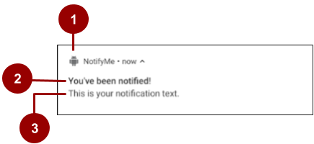
Setting notification contents
A small icon, set by setSmallIcon().
This is the only content that's required.
A title, set by setContentTitle().
The body text, set by setContentText(). This is the notification message.

Slide 45
Setting notification contents
NotificationCompat.Builder mBuilder =
new NotificationCompat.Builder(this, CHANNEL_ID)
.setSmallIcon(R.drawable.android_icon)
.setContentTitle("You've been notified!")
.setContentText("This is your notification text.");

Slide 46
Tap action
and
Action buttons

Slide 47
Add notification tap action
Every notification must respond when it is tapped, usually launching an Activity in your app.
Set an content intent using setContentIntent() method.
Pass the Intent wrapped in a PendingIntent object.

Slide 48
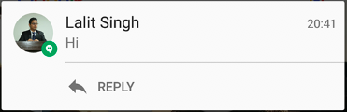
Notification action buttons
Action buttons can perform a variety of actions on behalf of your app, such as starting a background task, placing a phone call and so on.
Starting from Android 7.0 (API level 24) reply to messages directly from notifications.
To add an action button, pass a PendingIntent to the addAction() method.

Slide 49
Pending intents
A PendingIntent is a description of an intent and target action to perform with it.
Give a PendingIntent to another application to grant it the right to perform the operation you have specified as if the other app was yourself.

Slide 50
Methods to create a PendingIntent
To instantiate a PendingIntent, use one of the following methods:
PendingIntent.getActivity()
PendingIntent.getBroadcast()
PendingIntent.getService()

Slide 51
PendingIntent method arguments
Application context
Request code—constant integer id for the pending intent
Intent to be delivered
PendingIntent flag determines how the system handles multiple pending intents from same app

Slide 52
Step 1: Create intent
Intent notificationIntent =
new Intent(this, MainActivity.class);

Slide 53
Step 2: Create PendingIntent
PendingIntent notificationPendingIntent =
PendingIntent.getActivity(
this, NOTIFICATION_ID,
notificationIntent, PendingIntent.FLAG_UPDATE_CURRENT);

Slide 54
Step 3: Add to notification builder
To set tap action to the notification:
.setContentIntent(notificationPendingIntent);

Slide 55

Add action buttons
Use NotificationCompat.Builder.addAction() — pass in icon, caption, PendingIntent
.addAction(R.drawable.ic_color_lens_black_24dp, "R.string.label", notificationPendingIntent);

Slide 56
Managing Notifications
Setting styles
To create expandable notification that appear, use one of the helper classes to set the style using the setStyle() method.
mNotifyBuilder
.setStyle(new NotificationCompat.BigPictureStyle()
.bigPicture(myBitmapImage)
.setBigContentTitle("Notification!"));

Slide 57
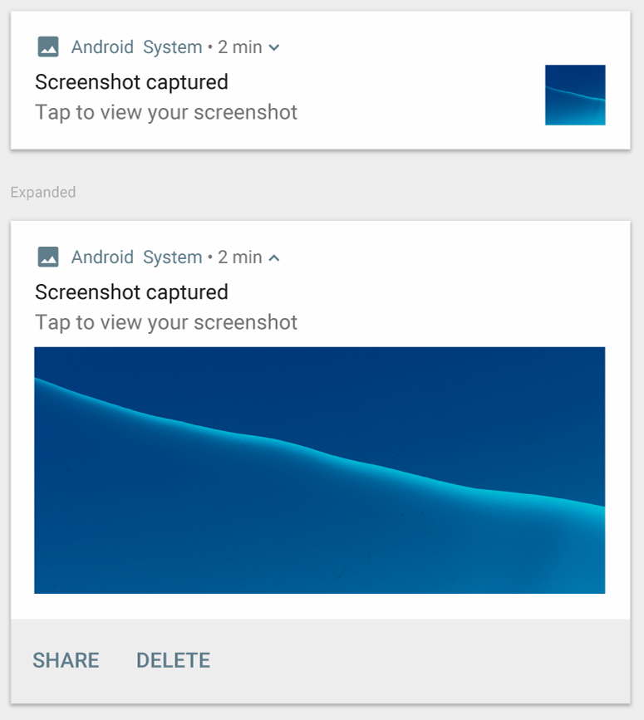
Big image
For large-format notifications that include a large image attachment.
Use the helper class:
NotificationCompa.BigPictureStyle

Slide 58
Delivering Notifications

Slide 59
Building a Notification
Delivering notifications
Use the NotificationManager class to deliver notifications.
Create an instance of NotificationManager
Call notify() to deliver the notification.

Slide 60
Building a Notification
Instantiate NotificationManager
Call getSystemService(), passing in the NOTIFICATION_SERVICE constant.
mNotifyManager = (NotificationManager)
getSystemService(NOTIFICATION_SERVICE);

Slide 61
Building a Notification
Send notification
Call notify()to deliver the notification, passing in these two values:
A notification ID, which is used to update or cancel the notification.
The NotificationCompat object that you created using the NotificationCompat.Builder object.
mNotifyManager.notify(NOTIFICATION_ID, myNotification);

Slide 62
Managing Notifications

Slide 63
Managing Notifications
Updating notifications
Update a notification by changing and or adding some of its content.
Issue notification with updated parameters using builder.
Call notify() passing in the same notification ID.
If previous notification is still visible, system updates.
If previous notification has been dismissed, new notification is delivered.

Slide 64
Managing Notifications
Canceling notifications
Notifications remain visible until:
User dismisses it by swiping or by using "Clear All".
Calling setAutoCancel() when creating the notification, removes it from the status bar when the user clicks on it.
App calls cancel() or cancelAll() on NotificationManager.
mNotifyManager.cancel(NOTIFICATION_ID);

Slide 65
Summary Steps
getSystemService(NOTIFICATION_SERVICE) -> Manager
new NotificationChannel and set its properties
Manager->CreateNotificationChannel
New NotificationCompat.Builder (set style if necessary)
Builder.build() -> Manager.Notify

Slide 66
7.4 Services

Slide 67
Contents
Services for long tasks.
IntentService

Slide 68
Services is an advanced topic
Services are complex.
Many ways of configuring a service.
This lesson has introductory information only.
Explore and learn for yourself if you want to use services.

Slide 69
Services for Long Tasks

Slide 70

What is a service?
A Service is an application component that can perform long-running operations in the background and does not provide a user interface.

Slide 71
What are services good for?
Network transactions.
Play music.
Perform file I/O.
Interact with a database.

Slide 72
Characteristics of services
Started with an Intent.
Can stay running when user switches applications.
Lifecycle—which you must manage.
Other apps can use the service—manage permissions.
Runs in the main thread of its hosting process.

Slide 73
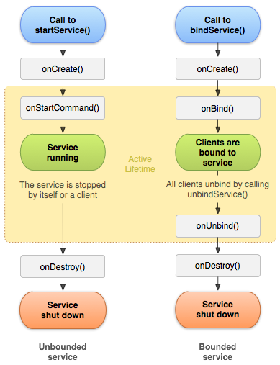
Forms of services: started
Started with startService()
Runs indefinitely until it stops itself
Usually does not update the UI

Slide 74
Forms of services: bound
Offers a client-server interface that allows components to interact with the service
Clients send requests and get results
Started with bindService()
Ends when all clients unbind

Slide 75
Services and threads
Although services are separate from the UI, they still run on the main thread by default (except IntentService)
Offload CPU-intensive work to a separate thread within the service

Slide 76
Updating the app
If the service can't access the UI, how do you update the app to show the results?
Use a broadcast receiver!

Slide 77
Foreground services
Runs in the background but requires that the user is actively aware it exists—e.g. music player using music service
Higher priority than background services since user will notice its absence—unlikely to be killed by the system
Must provide a notification which the user cannot dismiss while the service is running

Slide 78
Background services limitations
Starting from API 26, background app is not allowed to create a background service.
A foreground app, can create and run both foreground and background services.
When an app goes into the background, the system stops the app's background services.
The startService() method now throws an IllegalStateException if an app is targeting API 26.
These limitations don't affect foreground services or bound services.

Slide 79
Creating a service
<service android:name=".ExampleService" />
Manage permissions.
Subclass IntentService or Service class.
Implement lifecycle methods.
Start service from Activity.
Make sure service is stoppable.

Slide 80
Stopping a service
A started service must manage its own lifecycle
If not stopped, will keep running and consuming resources
The service must stop itself by calling stopSelf()
Another component can stop it by calling stopService()
Bound service is destroyed when all clients unbound
IntentService is destroyed after onHandleIntent() returns

Slide 81
END

